Slide 1

CourseCompass Final Presentation
Team Production Ready
MSSE 692 / October 18, 2026
Presented by
Euan Canoy
Preston Davis
Nhi La

Slide 2
Agenda
1
Problems and Proposed Solution
2
Architecture/Design/Tech Stack
3
Demo
4
Challenges and Lessons Learned
5
Next Steps

Slide 3
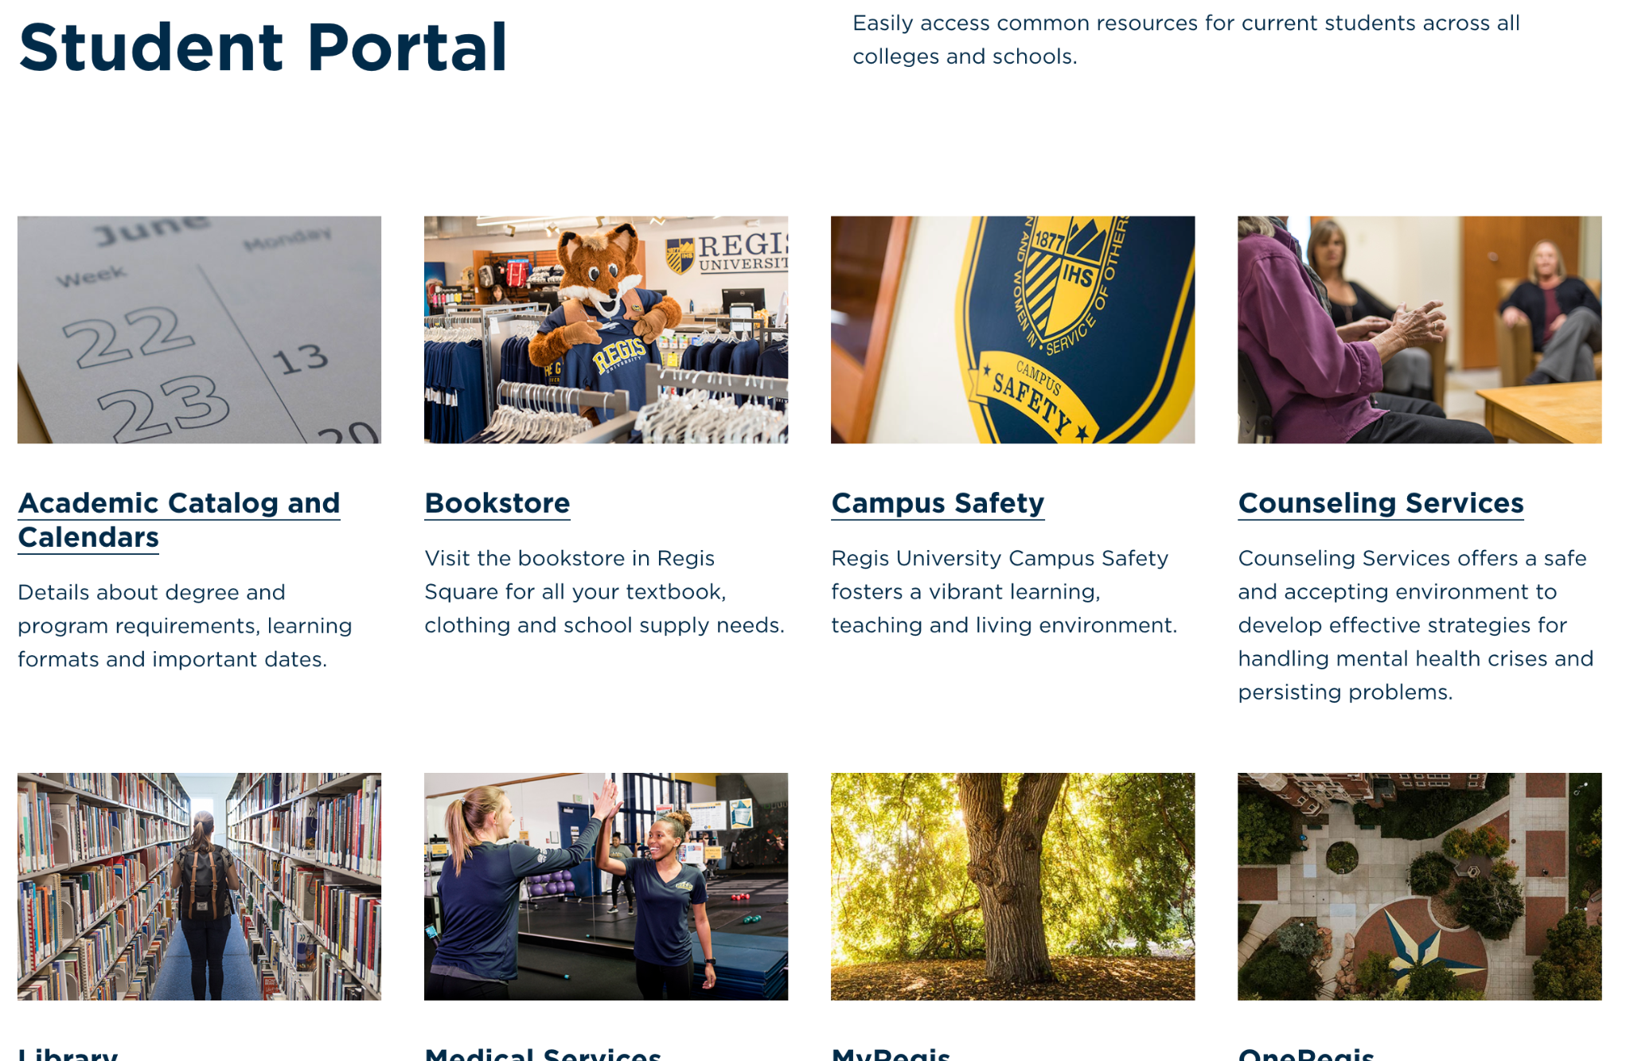
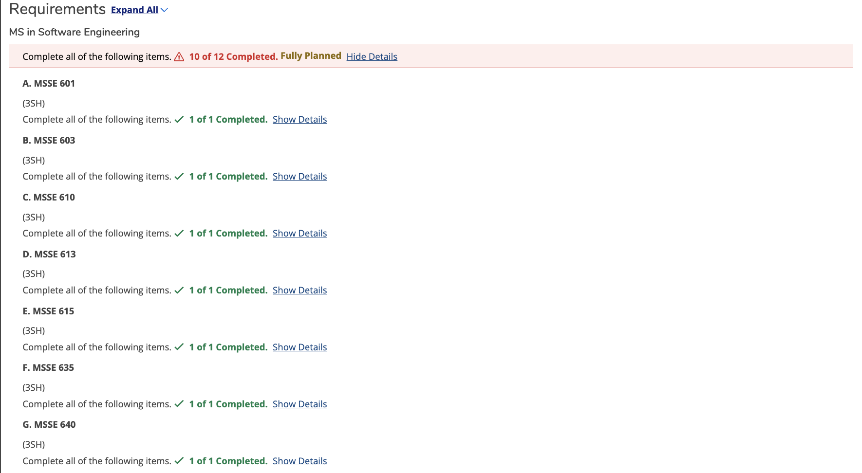


Problems Identified
Navigating endless resources
Generalized portal
Unique student situations
Accessibility to quick answers
Notes:
When I pitched this idea, I remember being a new student trying to plan my degree
Navigating endless resources and links
Once I accessed resources I realized the portal being generalized
Which required clicking through multiple links to find answers about
Unique student situation
I remember needing an excel sheet trying to plan my classes out
While advisors are great
My schedule didn’t always line up with advisors time
I wish I had something to answer quick questions

Slide 4
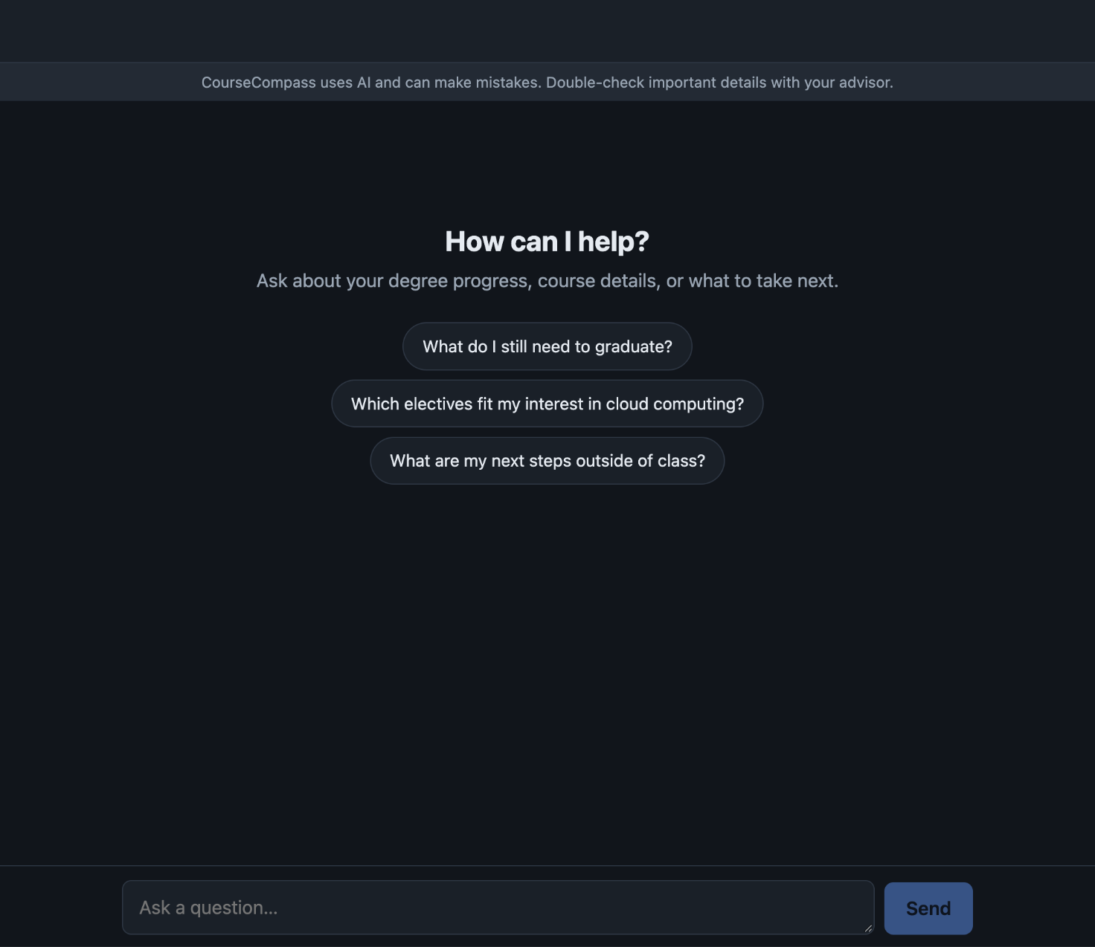
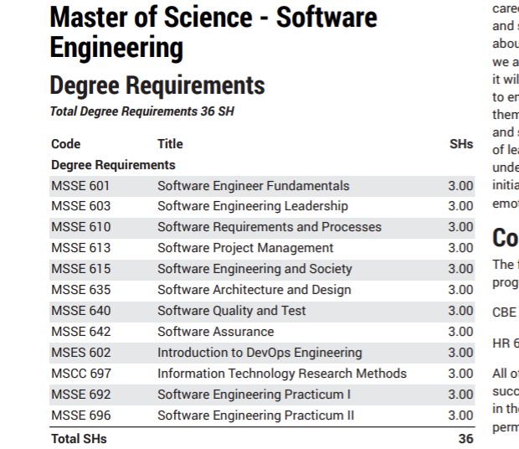
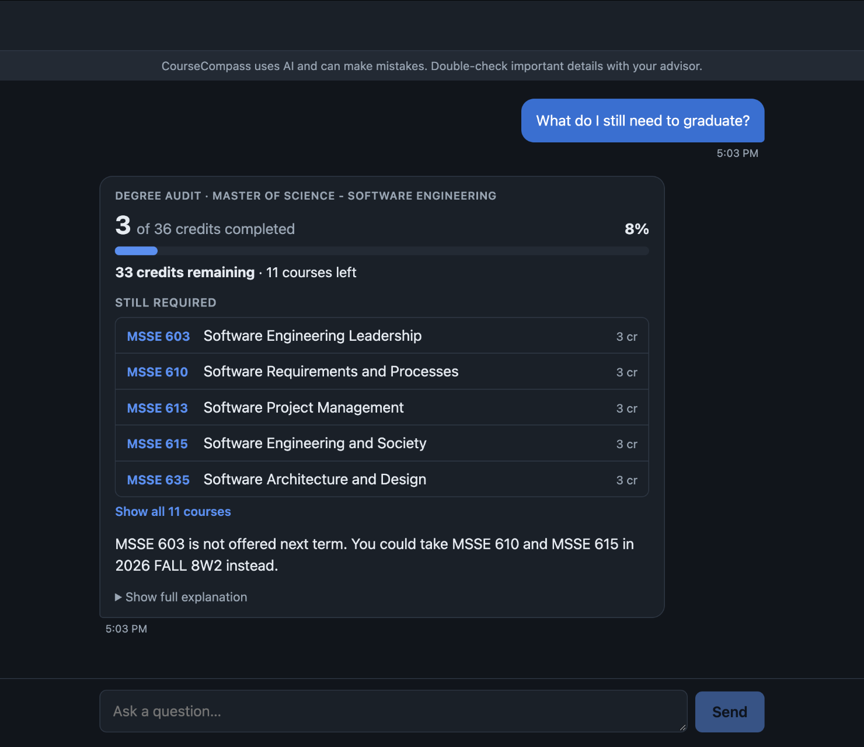
Solution - CourseCompass AI chatbot
Chat Interface
MSSE Dataset
Accurate
Notes:
Usable web interface should be created that allows users to submit questions and receive answers based on their advising needs
Create MSSE Dataset featuring courses prerequisites and class information and syllabi
Accurate information being provided by AI. Defining a scope that allows the chat

Slide 5



Target Audience
Students
Faculty and Advisors
Resources

Slide 6
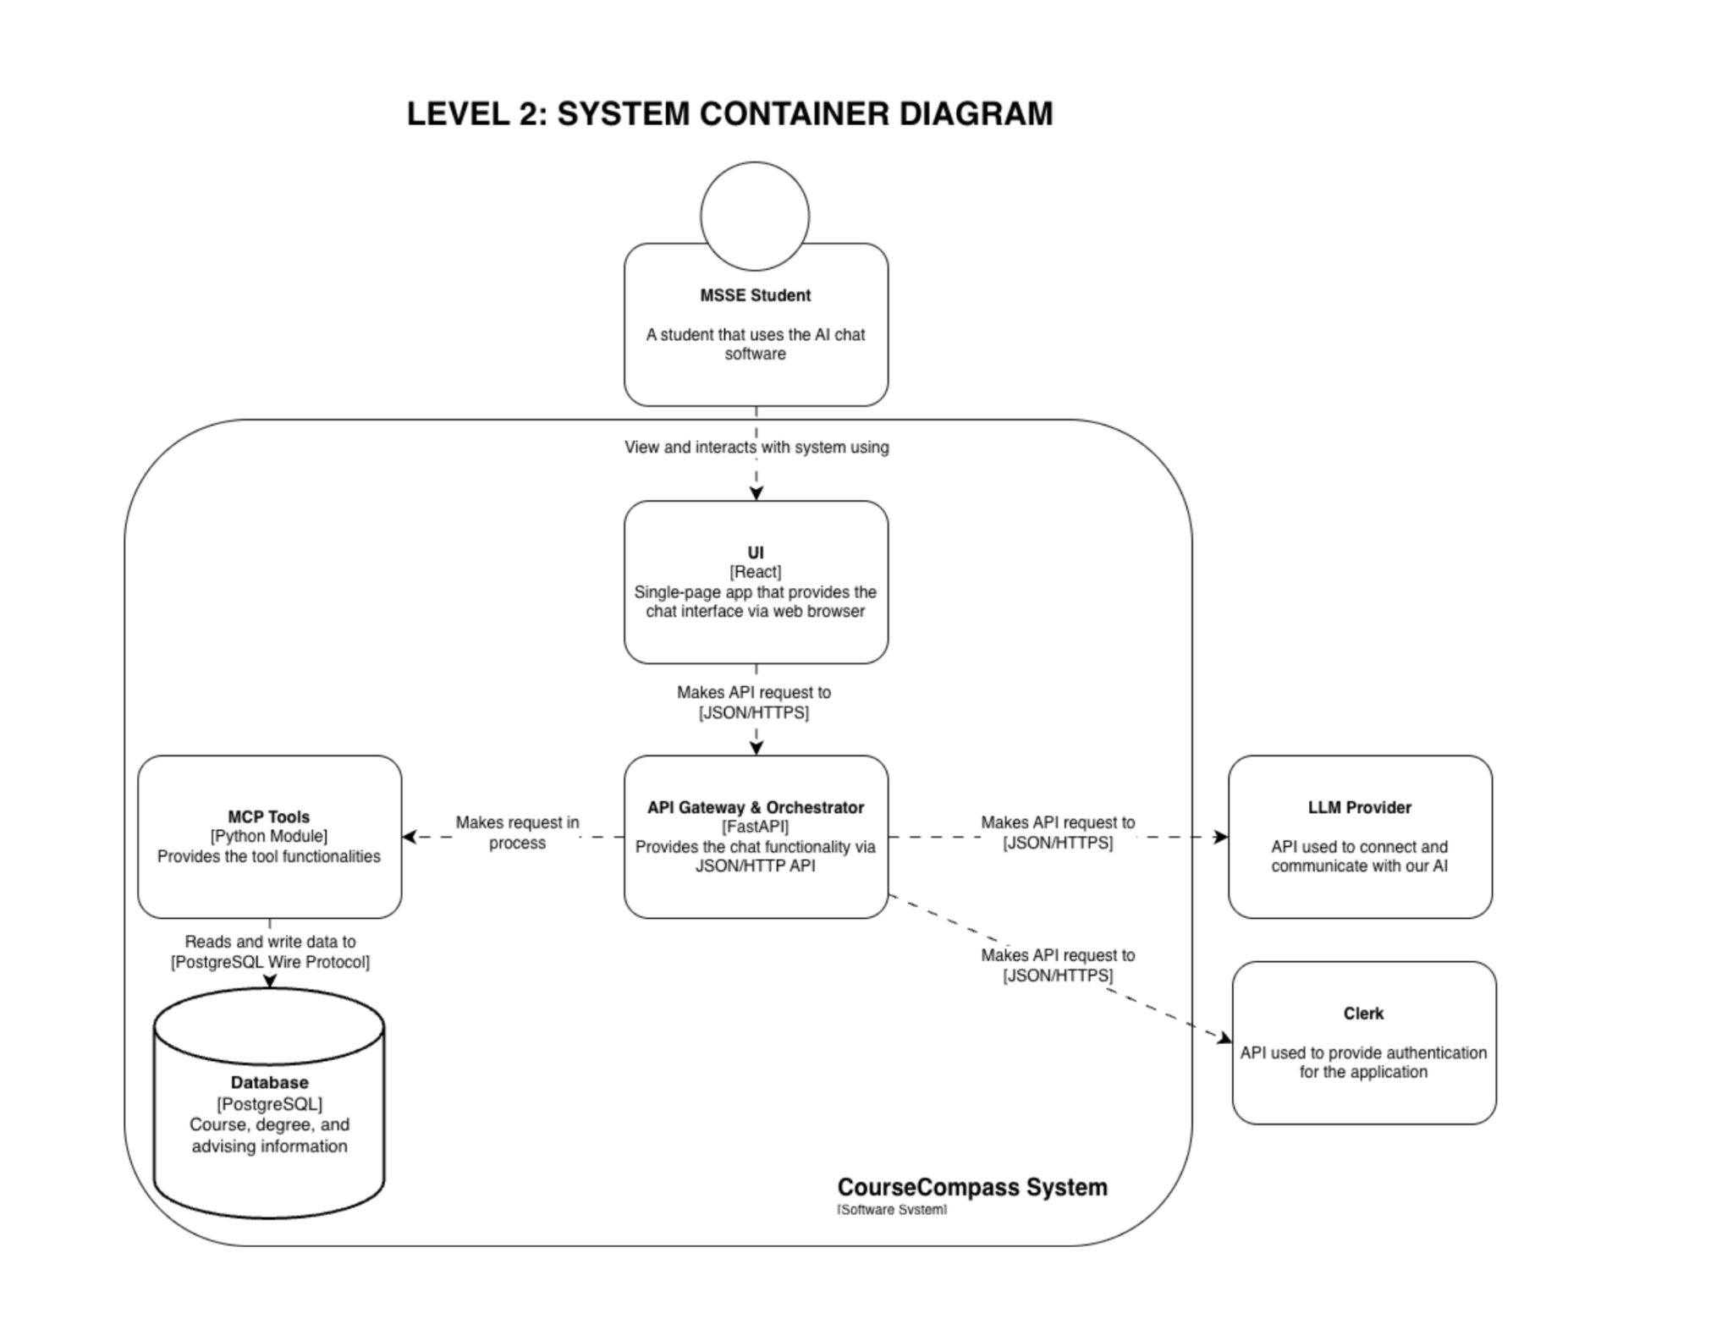
Architecture

Slide 7
Design Decision
Modular monolith
The model only picks a tool
Identity stays on the server
One FastAPI service with clear modules. Tools are in-process function calls, not a separate server, so there were fewer moving parts to build and test.
Gemini chooses from a fixed list of tools and phrases the result. Every fact comes from our database, so it cannot invent course data.
Clerk tokens are verified in the backend. The student ID never goes to the model and never comes back in a response.

Slide 8
Design Decision
PostgreSQL + pgvector
Migrations build the schema
One database for course data and syllabus text, with an embedding column ready for vector search.
Sixteen migration files plus a re-runnable seed. After our mid-project rebuild, the schema returned in minutes.
Repositories hide the vendors
Added three layers of protection
Interfaces keep the database and LLM apart from the rest of the code. We swapped LLM providers in under 3 hours.
A 'maintenance mode' query leaked tool output. Fixed with three layers: input rules, a phrasing skip, and a leak filter.

Slide 9
Data Model
Student
Catalog
Calendar
Advising
programs
students
transcript_entries
courses
prerequisites
requirements
syllabus_chunks
terms
course_offerings
schedules
schedule_terms
schedule_items
advisor_contacts
milestones
data_ingestion_logs
3 important schema choices:
One login, one student
Prerequisites from the syllabi
Ready for vectors

Slide 10
Technology Stack
Layer | Choice
Frontend | JavaScript, React, Vite, Vitest
Auth | Clerk
Backend | Python, FastAPI, pytest
AI | Vertex AI: Gemini 2.5 Flash, gemini-embedding-001
Database | PostgreSQL 18 + pgvector (Cloud SQL)
Hosting | Vercel (Frontend), Google Cloud Run (Backend)

Slide 11
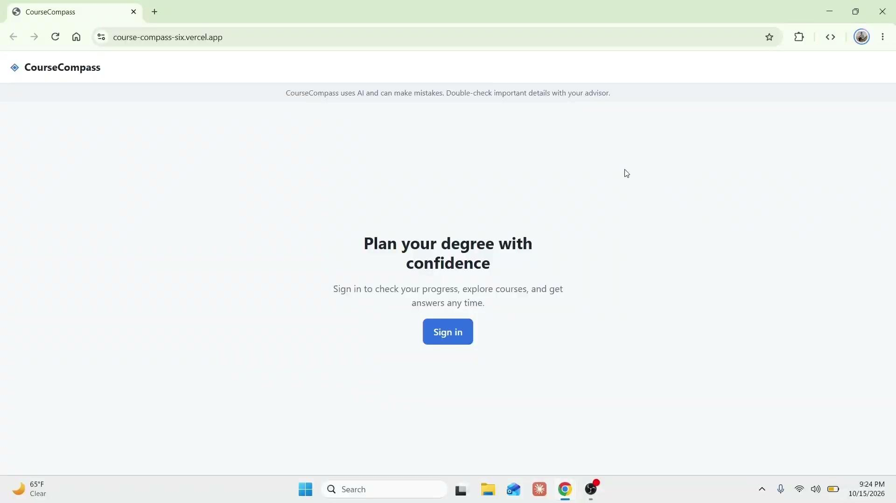

Slide 12



Challenges
Unfamiliar tech stack and architecture
Distributed team across two time zones
First time working on a team and a project at this scale
Notes:
Unfamiliar tech stack and architecture: Most of the team had no experience setting up a cloud deployment environment or working with MCP tools and LLMs or the architecture that was required to make them work (like tooling layer, repository layer, etc.). This all had to be researched and learned as we were developing the application.

Slide 13



Lessons Learned
Importance of planning and design stage
First time use of tools comes with unexpected challenges
Integration is an all hands experience

Slide 14



Next Steps
Add More Programs and Degrees
Transcript Uploads
Schedule Builder
Notes:
Implement new features
Improve performance
Improve testing

Slide 15
Conclusion
Thank you for listening

Slide 16
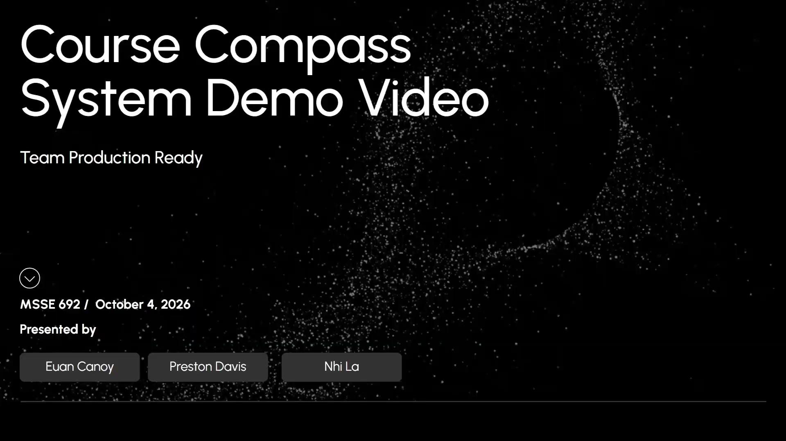

Slide 17
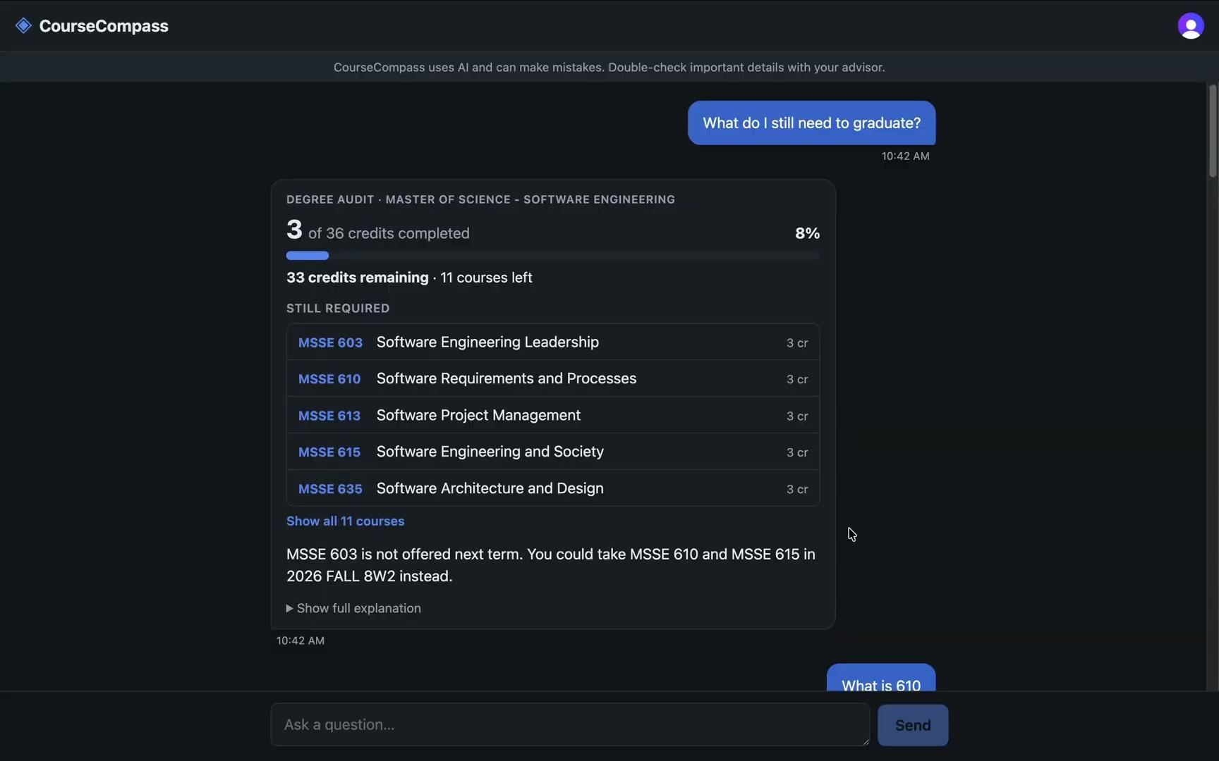

Write a bold, compelling statement about what the company wants to achieve.
Our mission
Company Name
Quarter Month
Year

Slide 18
Technical Highlights
1
2
3
All of the prerequisites modeled exactly as the real syllabus specifies, no approximation
LLM restricted to fixed tool calls only, no direct data access, no invented facts
Confirmed this week: real end-to-end flow, chat → API → database → response

Slide 19
Limitations
Performance: 8–15 sec actual vs. 5 sec target
Latency between query and response is our biggest bottleneck (Cloud Run cold starts, external API calls)
Still acceptable, budget mattered more to us than raw speed

